Slide 1

The beginning of your journey
Notes:
欢迎加入我们le wagon part-time产品开发培训营！你们准备好了吗！
Welcome to the Le Wagon part-time product development bootcamp! Are you ready?!

Slide 2

A Programmer’s way of thinking
Notes:
程序员的思维方式是什么呢？
How do programmers think?

Slide 3

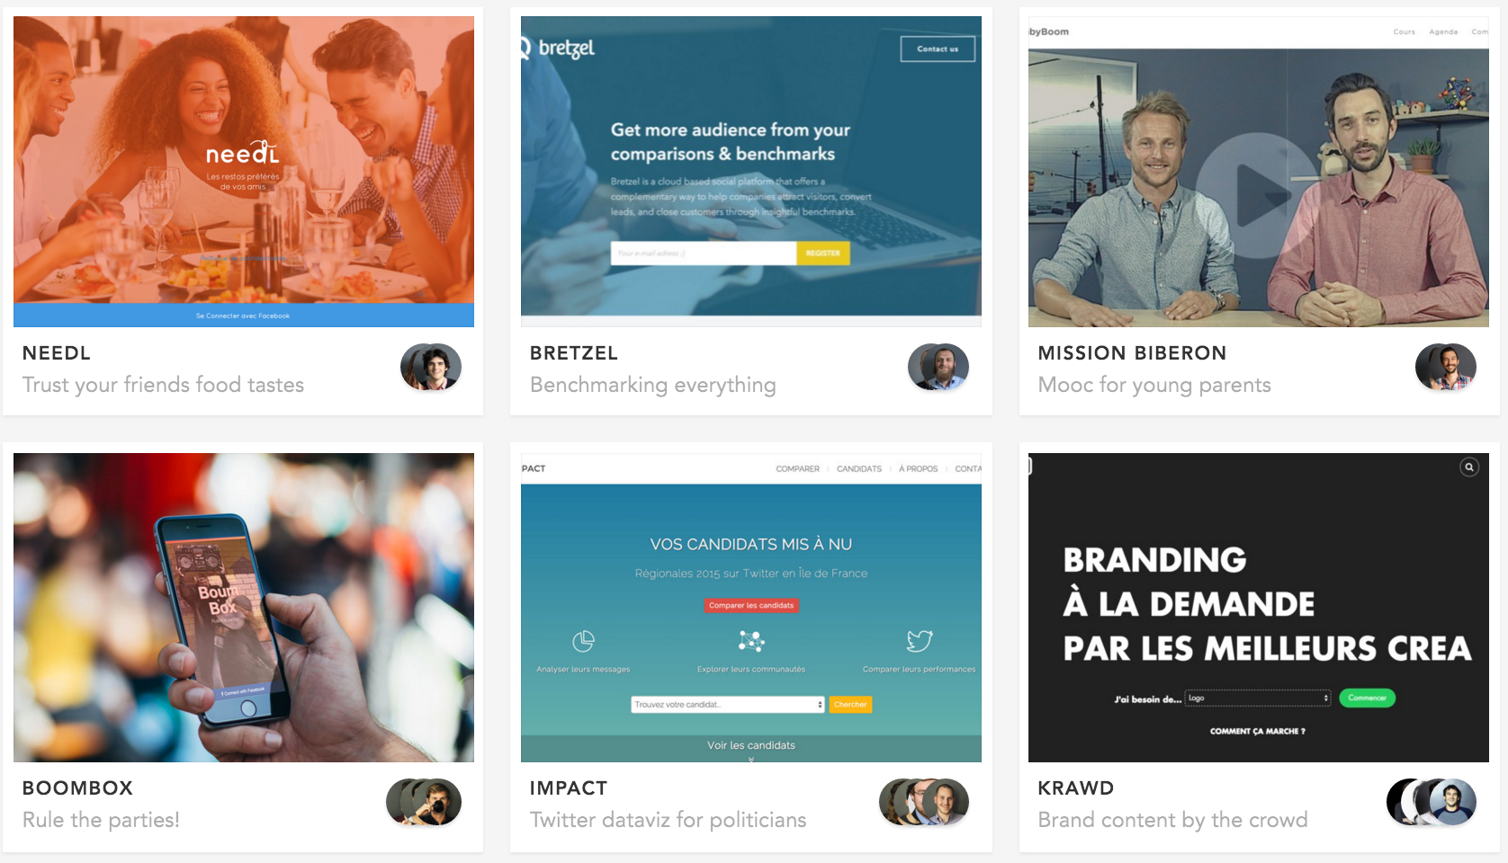
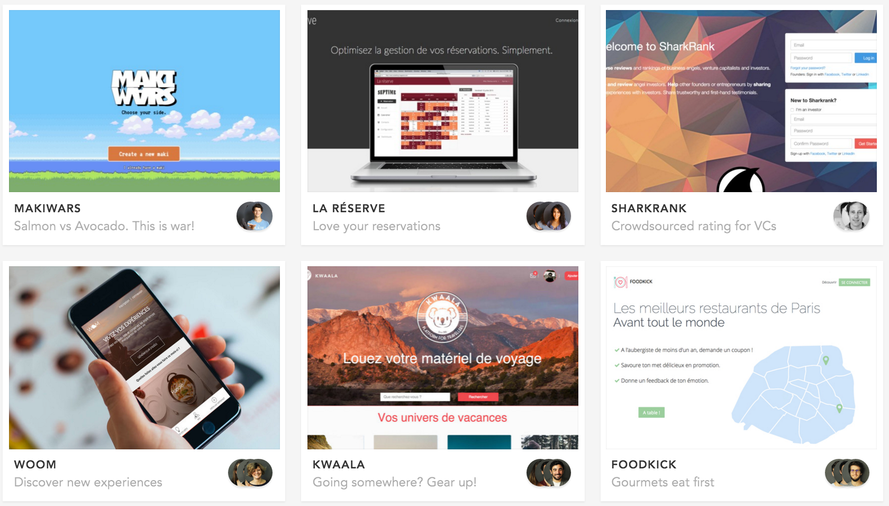
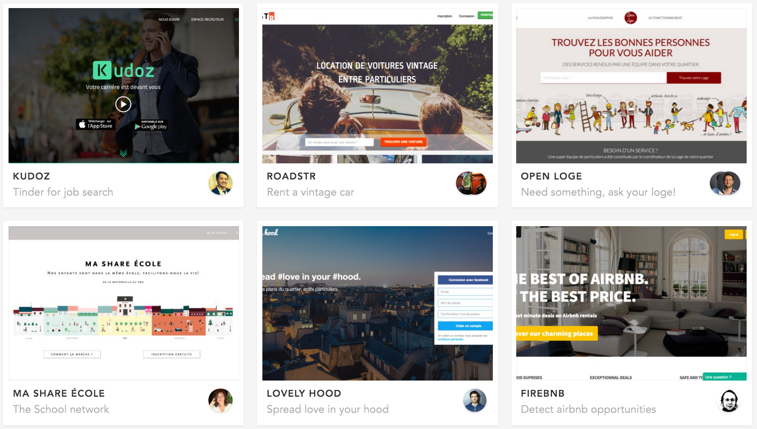
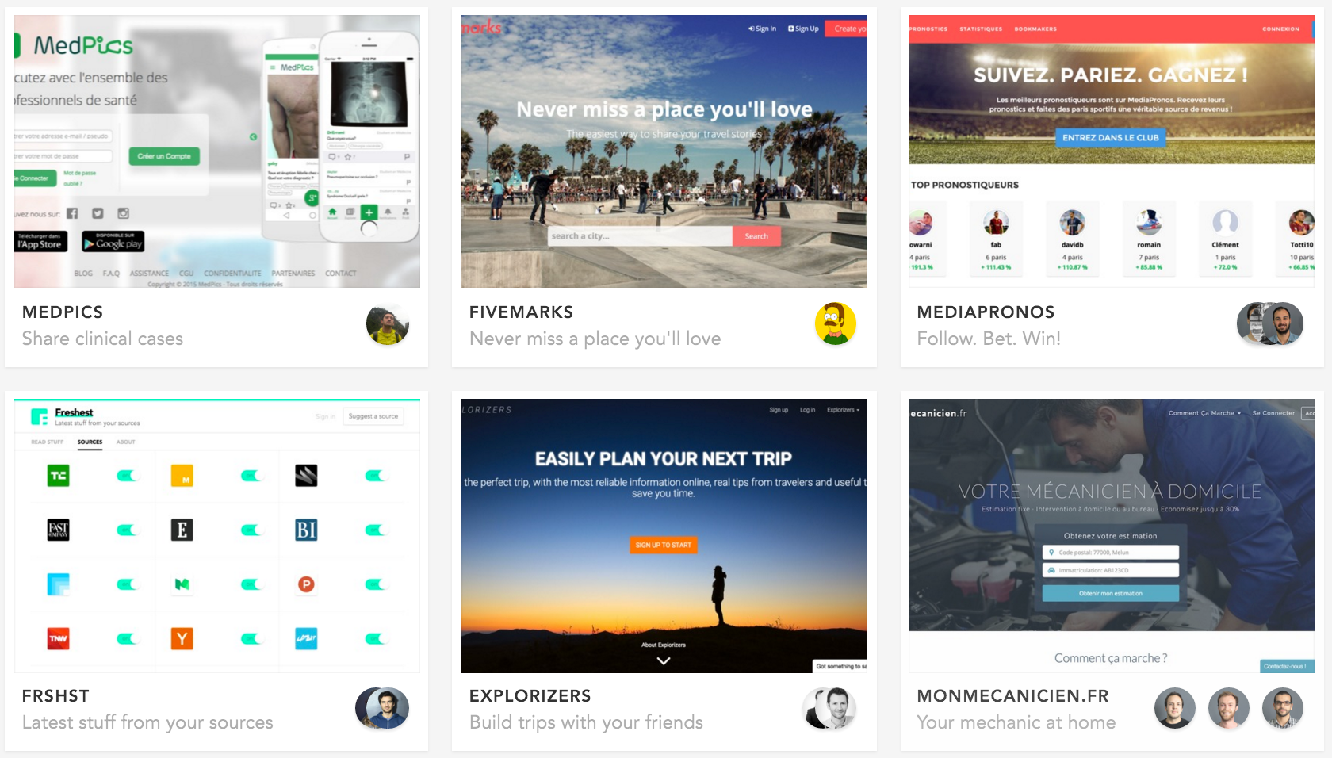
Build products
by coding 🔨
Notes:
很简单：他们用代码来构建产品
The answer is simple: they use code to build products

Slide 4
This requires strong
knowledge and skills💪
Notes:
编码需要丰富的知识以及技能，这就不用多说了
Coding requires strong knowledge and skills, this should go without saying

Slide 5
What does coding involve?
Product thinking: Which type of product to build🤔
Engineering: How to build the product ⚙️
UI & UX: How to make it most intuitive👌
Design: How to make it beautiful💖
Notes:
What does coding actually involve?
There are four key areas:
1. Product thinking: Which type of product to build
2. Engineering: How to build the product
3. UI & UX: How to make it most intuitive
4. Design: How to make it beautiful
代码到底是什呢？
需要考虑到四个主要方面
1. Product thinking 你想构建什么样的产品呢？
2. Engineering工程：如何打造你的产品
3. UI & UX：如何让你的产品直观
4. 设计：如何美化你的产品

Slide 6

We don’t lecture like in a traditional
CS degree
We teach you how to build products
Notes:
我们不会像传统计算机科学学位那样教你
而 我们将教你如何制造产品
We will not teach you like the traditional CS degree, we will teach you how to make products

Slide 7
That being said,
there is no shortcut😊
This course covers the main
programming concepts
Notes:
然而，没有捷径 méi yǒu jié jìng
there are no shortcuts
本课程将涵盖一些主要的编程概念

Slide 8

Hold on.
Trust us.
Stay curious.
Notes:
You will find this course very challenging,
But don’t worry,
do not give up
Believe in us
Remain curious
你会发现这门课很有挑战性，
但不用担心，
不要放弃
相信我们
保持好奇心

Slide 9
Schedule every Tues & Thurs
18:30 - 19:00 | Arrive on campus
19:00 - 20:30 | Lecture
20:30 – 22:00 | Complete the exercises with your buddy
Notes:
准时到达
教课
Please arrive on time!

Slide 10
Schedule every Saturday
8:30 - 9:00 | Arrive on campus
9:00 – 18:00 | Complete the challenge with your buddy

Slide 11
Rules
Please do not be late ⏰
No food allowed during class🙅‍
No phone/laptop during lecture📵
Work with your assigned buddy for the day👯‍
Leave the desk clean and tidy when you leave✨

Slide 12
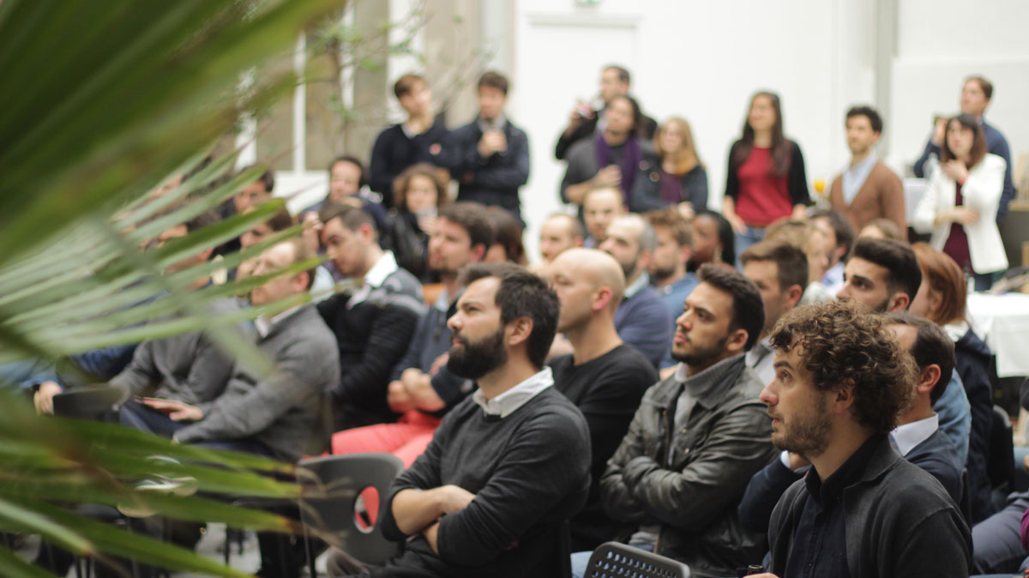
Social activities
🎤 Events/Talks
Notes:
We will also hold some activities, everyone can participate, know more about some companies, CEOs and so on.
This time there are 3 camps happening concurrently, so we will have the opportunity to share events and network together.

Slide 13
Today’s schedule
Today
9:30 - 12:00 | Setup
13:00 - 13:15 | Lecture: Command Line
13:15 - 14:00 | Lecture: Git
14:00 – 14:15 | Intro to the learning platform
14:15 – 16:00 | Complete exercises
16:00 | Project pitch introduction

Slide 14
Are you ready? 🚀
Notes:
大家准备好了吗？

